Slide 1
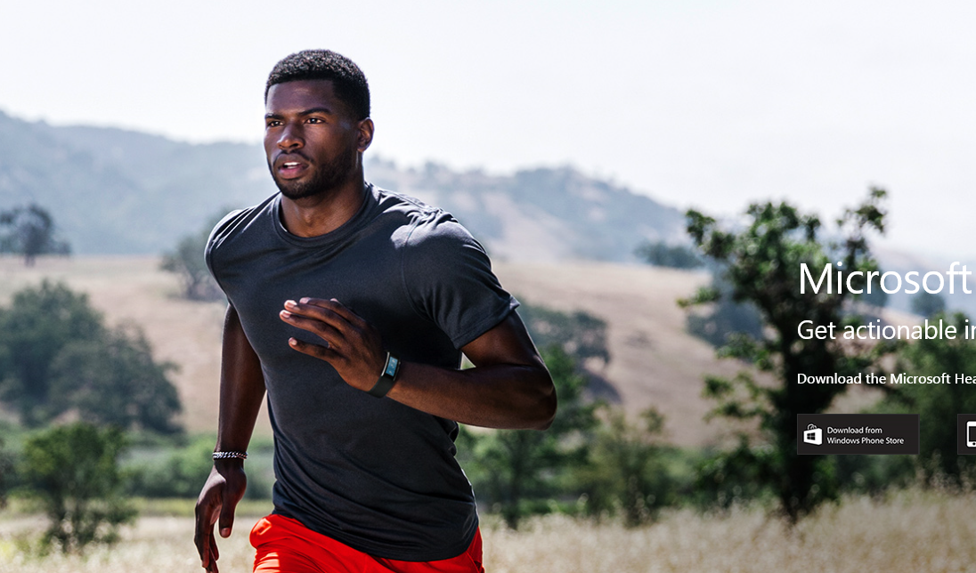
Microsoft Band on the Run – From Heartbeat to Cloud
Peter Daukintis @peted70
David Gristwood @scroffthebad
Microsoft
Notes:
We’re going to talk today about the Microsoft Band which is a consumer wearable optimised for health and fitness. It is jam-packed with sensors and we are going to talk around a project that we have developed which demonstrates how to manage real-time data coming from those sensors. We’ll show data capture, ingestion to the cloud, how to transform and analyse and how to publish the data to various client apps.

Slide 2
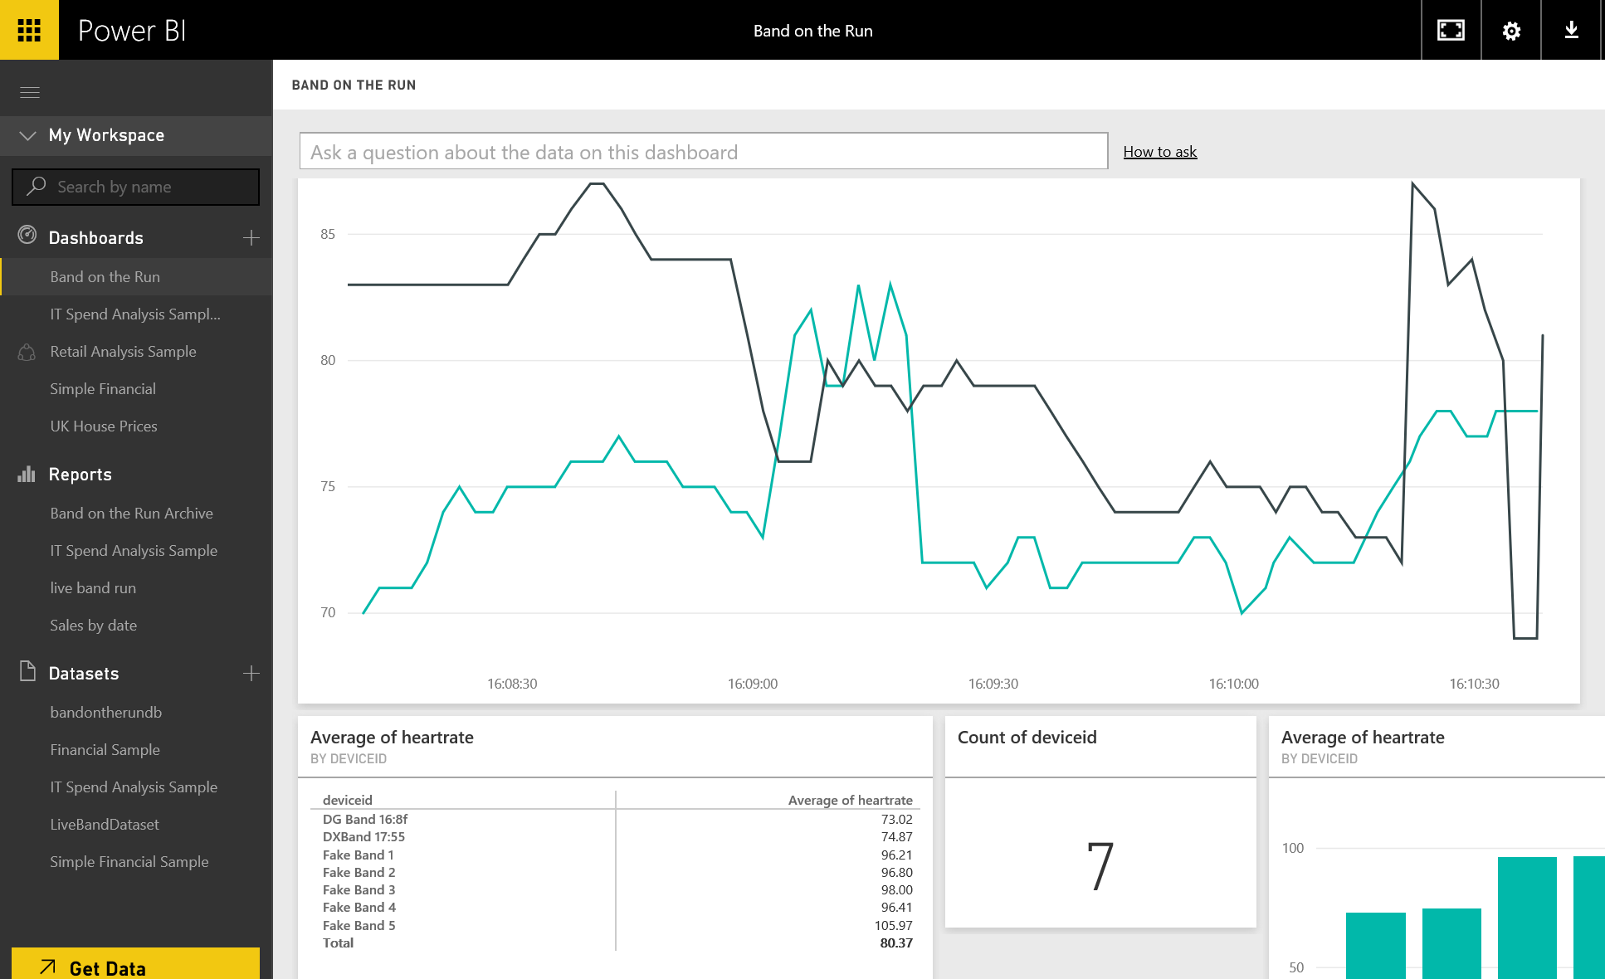
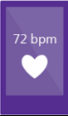
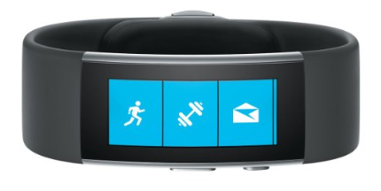
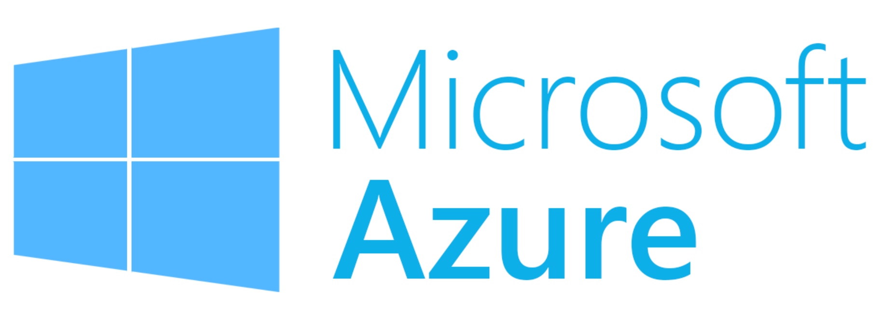
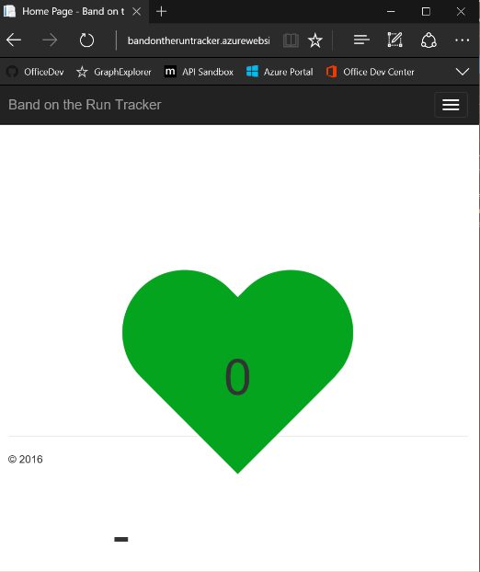
Taking control of your Microsoft Band data
https://github.com/BandOnTheRun
Notes:
We called the project Band on the Run – we don’t expect there to be any copyright issues with that ☺
The project can be summarised with this data journey;
Starting from the heart as blood is pumped through capillaries close to the skin, the changes in skin tone are detected by the optical heart rate sensor which is here on the band

Slide 3
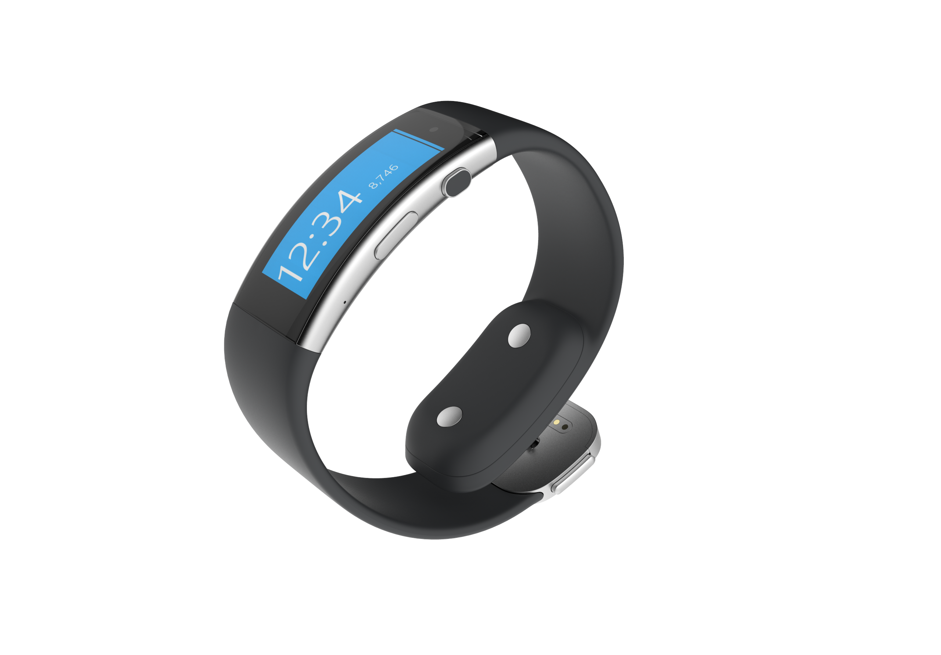
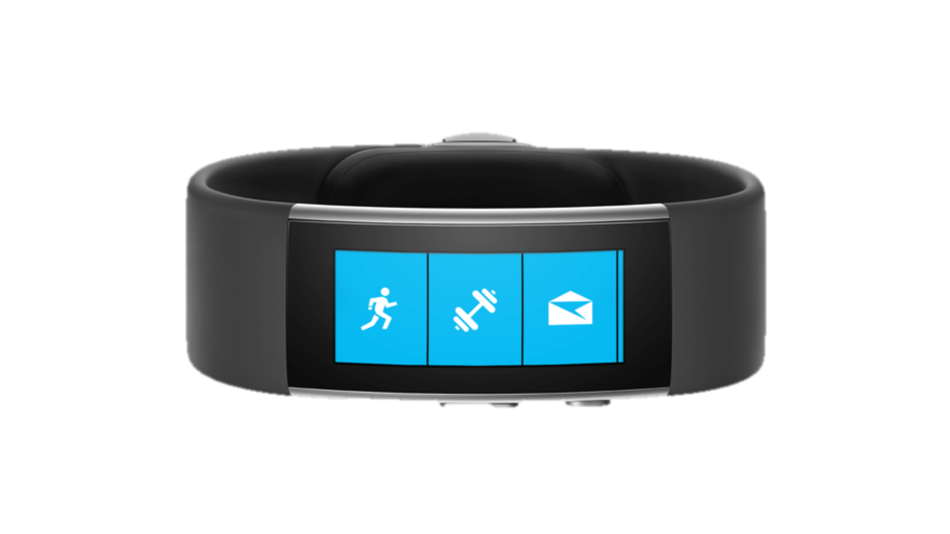
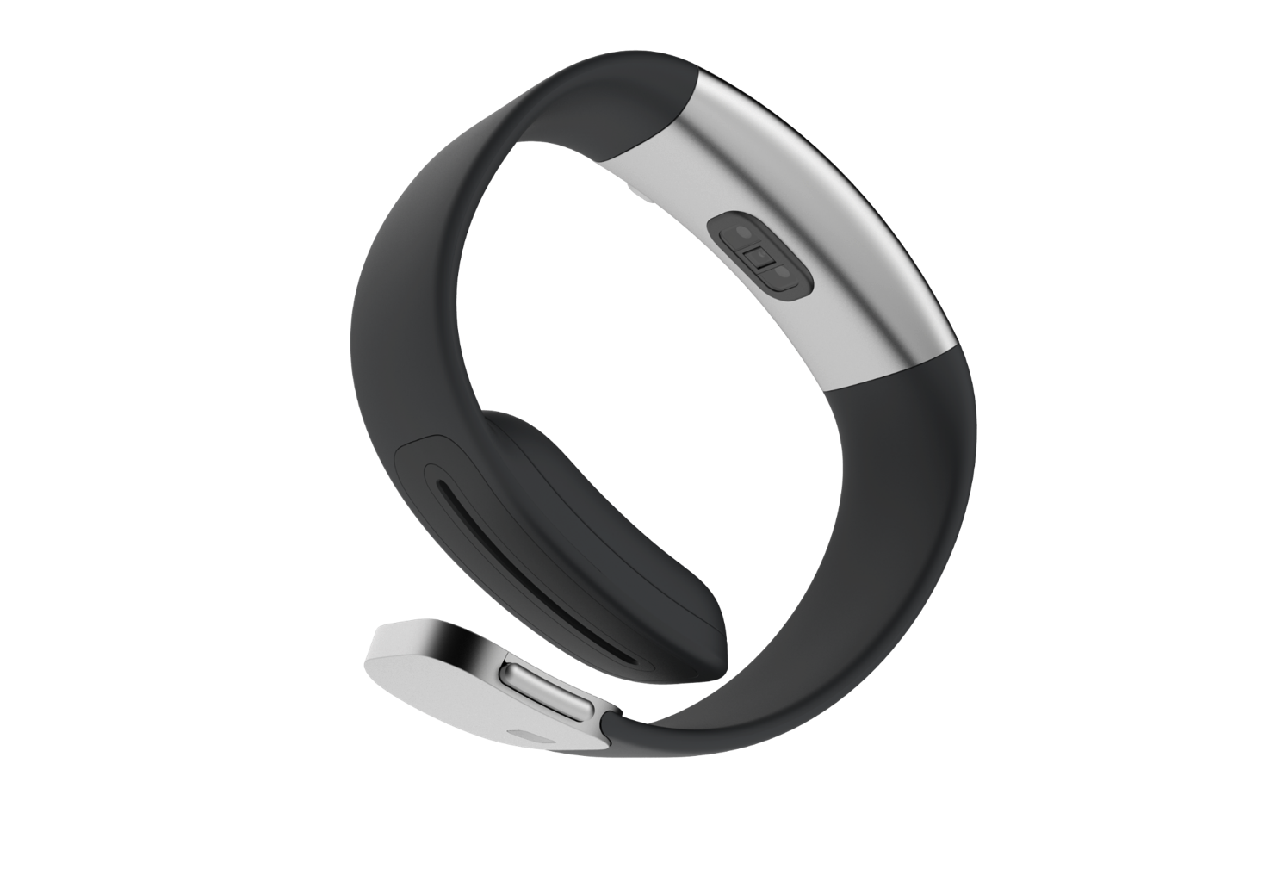
Curved Display
Corning® Gorilla® Glass
Stainless Steel Casing
Metal Finishes
Sliding Clasp
Notes:
Materials – stainless steel casing, buttons & clasp give it most premium look & feel; We feature higher-end materials with this product
Clasp – enhanced version of our v1 clasp; looks more refined and from a functionality point of view, it help us to fit 90% of the populations wrists with the sliding technology
Microsoft Band is a small device packed with 11 sensors all placed strategically to balance the weight of the device and allow for the most comfortable fit & accuracy of read

Slide 4
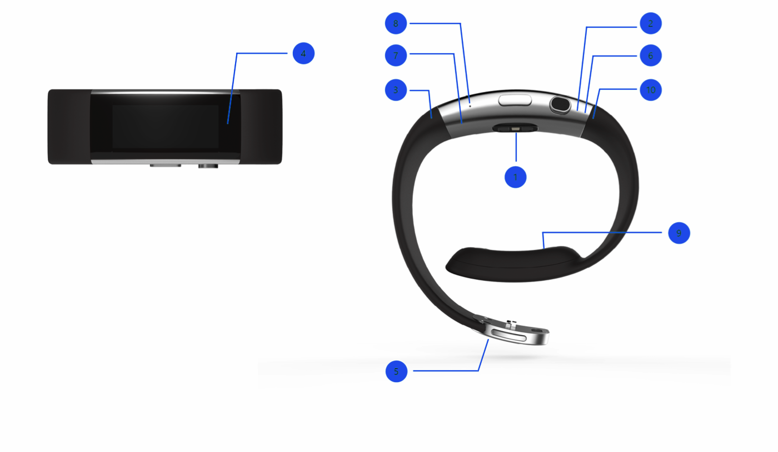
Packed With Sensors
Technology
Understanding the technology and different inputs will help you design the best experience for your user.
8
2
4
7
6
3
10
1
Optical heart rate sensor
2
3-axis accelerometer/gyroscope
3
GPS
1
4
Ambient light sensor
5
UV sensor
6
Capacitive sensor
9
7
Haptic vibration motor
8
Microphone
9
Galvanic skin response
10
Barometer/altimeter
5
11
Skin temperature sensor
Notes:
Add sensor descriptions
Missing one sensor – skin temp

Slide 5
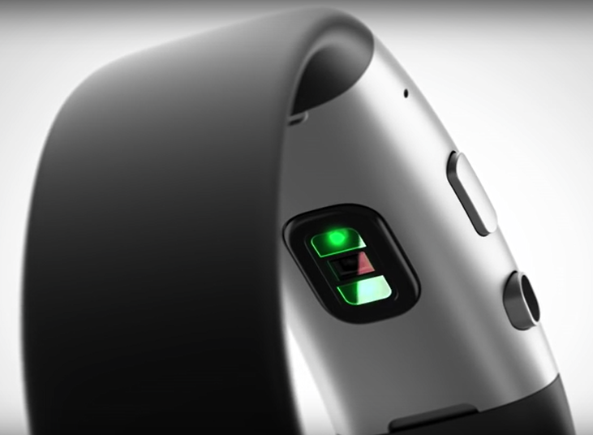
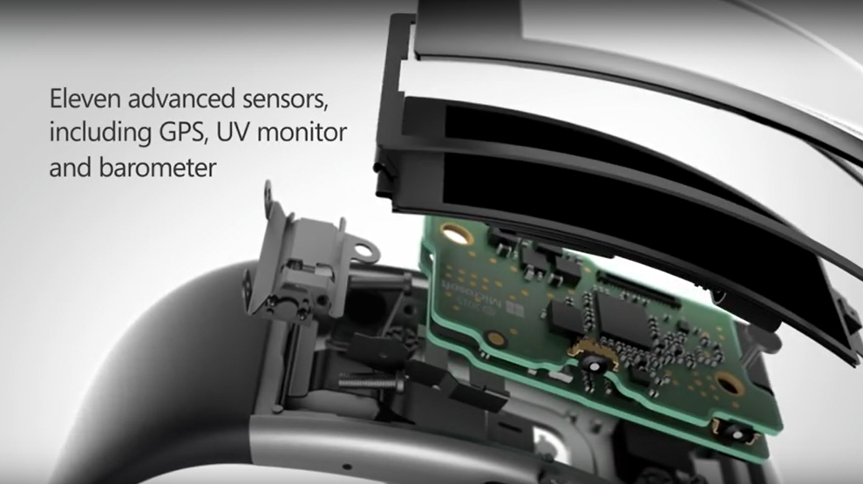
Microsoft Band
All day wearable device
Live healthier, be more productive
Stay connected at a glance
Notes:
Onto the band:
It is designed to be worn 24hrs a day and is optimised around battery usage – battery will last up to 48 hrs depending on usage. It can provide calendar, email notifications, you can use it with Cortana Microsoft’s digital assistant. And it has various activity modes; running, sleeping, free exercise and a few others. There are two main paths for data to flow from the band:

Slide 6
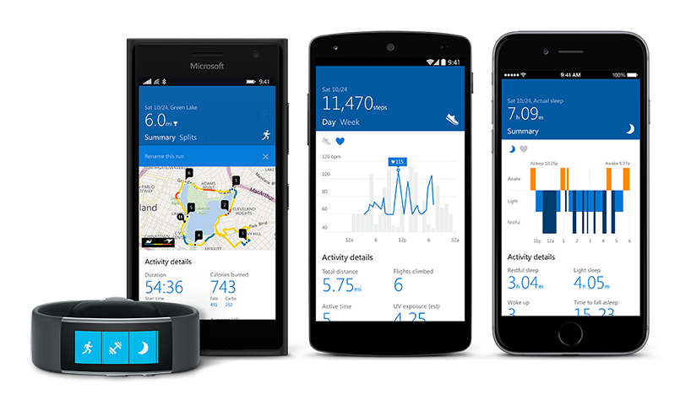
Microsoft Health app
Notes:
The first is the main consumer mode where, for example, if you go for a run you would put the band into run mode which sets up the right sensors and reading frequency for that particular activity, so in the case of running turns on GPS sensor and records heart rate. You would then run and the data is stored in the memory on the band (note that you don’t need to take your phone with you). When you are back in range of the phone the data will be synced to the phone and then posted up to the cloud.

Slide 7
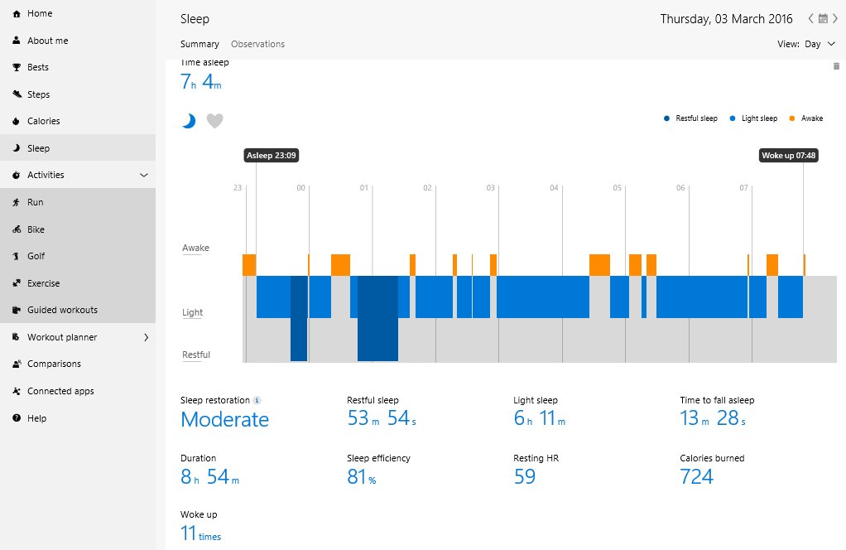
Microsoft Health API Preview
https://dashboard.microsofthealth.com
Notes:
Troubleshoot sync issues http://www.microsoft.com/microsoft-band/en-us/support/phone-app/troubleshoot-Bluetooth

Slide 8
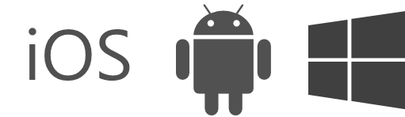
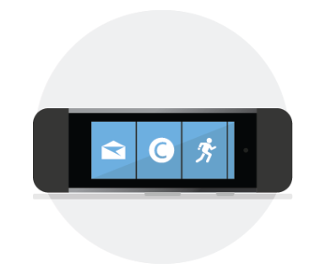
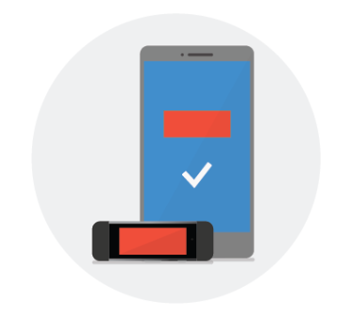
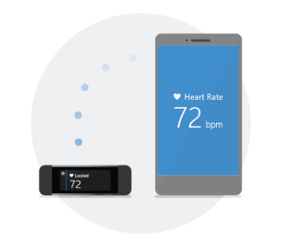
Microsoft Band SDK
Create your tile
Personalize your app
Access sensors
Notes:
The Band SDK is available for creation of IOS, Android and Windows and it provides three main functions:
Create an app tile – this is not code that runs on the band itself but a Bluetooth communication between a phone app and the band. You can send notification and data back and forth.
Personalise the band – so set theme colours and wallpaper, etc.
And finally, the one we are most interested in accessing data from the sensors…

Slide 9
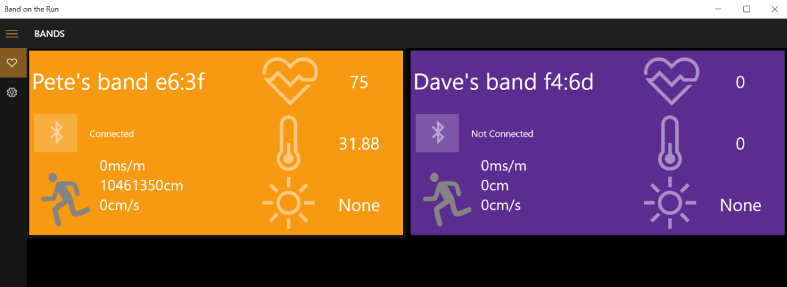
Universal Window Platform App
Notes:
Our demo app creates a tile for each paired band and enables you to connect and shows live updates from the band sensors.

Slide 10
Programming Model
Band Client Manager
Band Client
Personalisation Manager
Tile Manager
Sensor Manager
Notification Manager
Heart Rate
UV
Skin Temp
Reading Changed Event
START
READING
Request Consent
Notes:
Currently only the heart rate data requires consent.

Slide 11
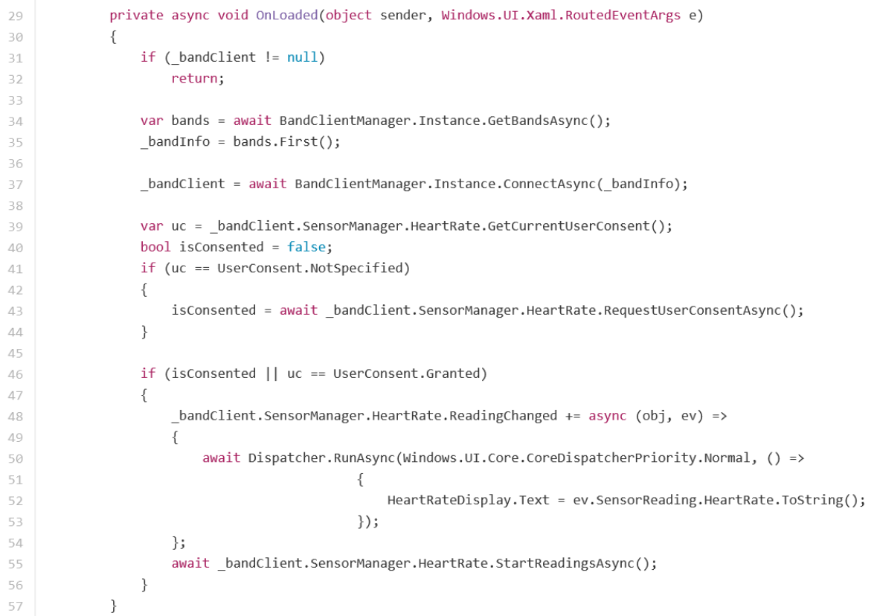

Slide 12
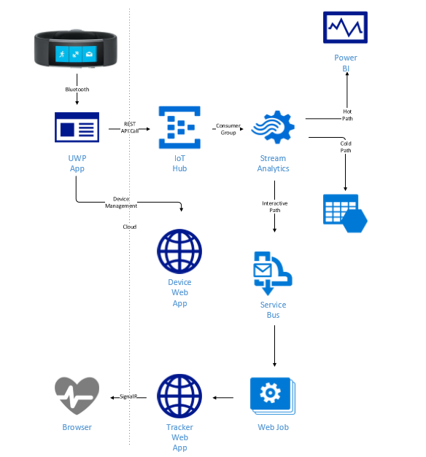
Band on the Run Cloud

Slide 13
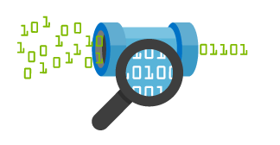

Azure IoT Hub
Telemetry ingestion
Millions of devices
Secure bi-directional communication
AMQP, HTTP, MQTT, custom protocols
Multiple platforms device SDKs
IoT Hub
Event processing and insight
(e.g., hot and cold paths)
IP-capable
Cloud protocol
gateway
Device business logic,
connectivity monitoring
Field gateway
PAN-devices
Application device provisioning and management
field
cloud

Slide 14
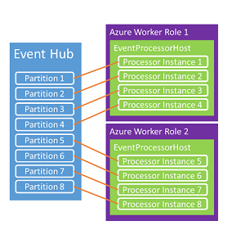
Consumer Groups
Instantiate EventProcessorHost Class
Register your IEventProcessor implementation
Host will attempt to acquire a lease on every partition
Over time the load shifts between nodes as lease expires
Host implements storage-based check-pointing mechanism per partition

Slide 15

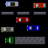
Azure Streaming Analytics
Data at Rest
Data in Motion
Stream millions of events per second
Time based
Mission critical reliability
SQL-like language
Create real time alerts

Slide 16
Windowing Concepts
Aka Complex Event Processing
Tumbling, hopping and sliding Windows
Windows are fixed duration
Timestamp of end of the window
A 10-second Hopping Window with a 5-second “Hop”
1
5
4
6
2
8
6
5
3
6
1
0
5
10
15
20
25
30
Time
(secs)
1
5
4
6
2
4
6
2
“Every 5 seconds give me the count of tweets over the last 10 seconds”
8
6
8
6
5
3
SELECT Topic, Count(*) AS TotalTweets
FROM TwitterStream
TIMESTAMP BY CreatedAt
GROUP BY Topic, HoppingWindow(second, 10, 5)
5
3
6
1

Slide 17
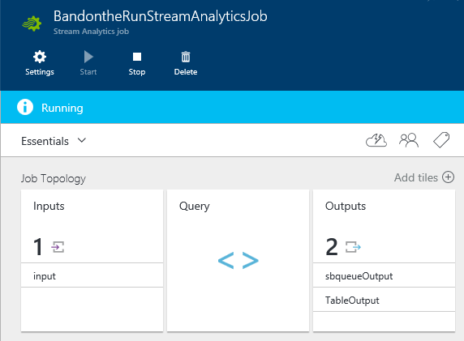
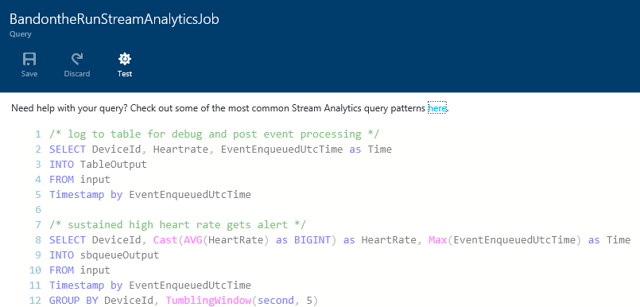
Azure Portal

Slide 18
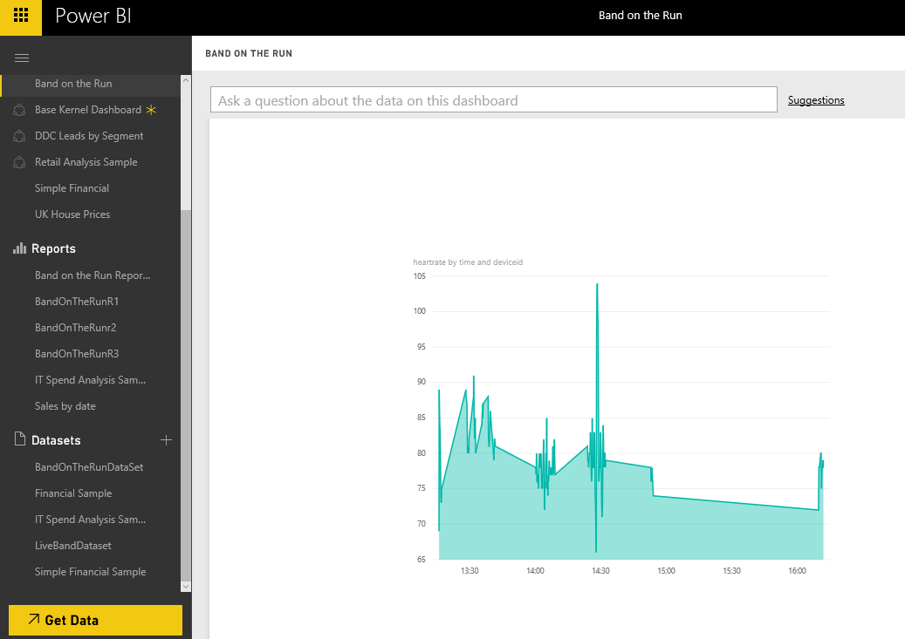
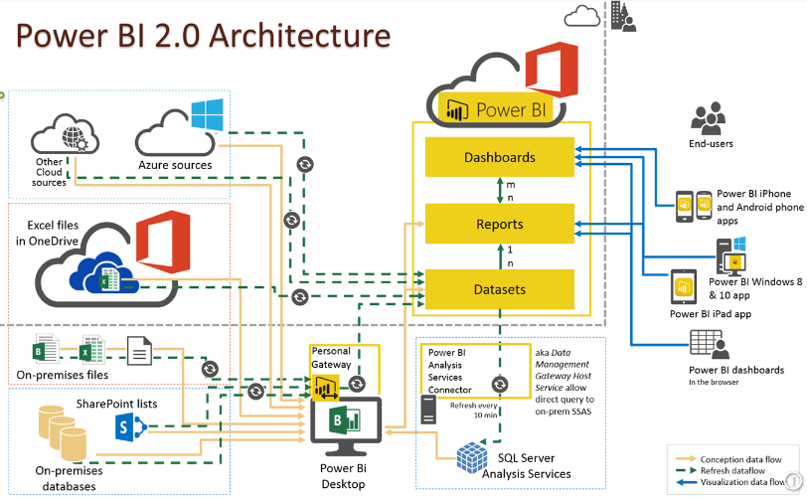
Power BI

Slide 19
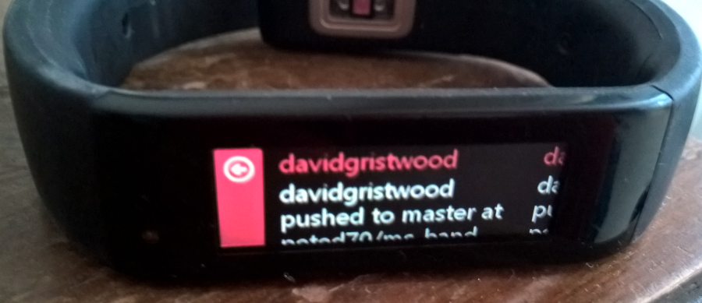

Band on the Run @ GitHub
https://github.com/BandOnTheRun/

Slide 20
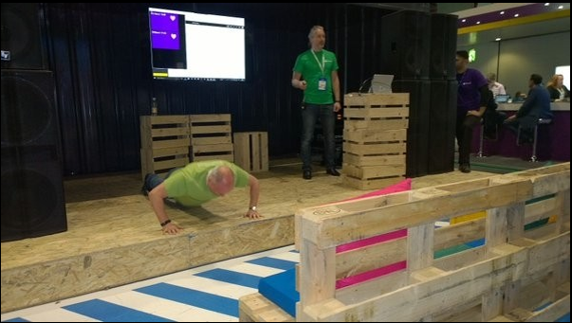
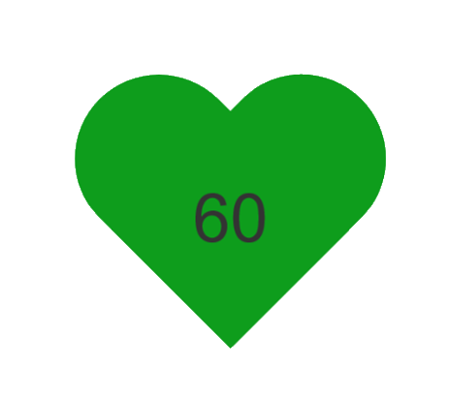
Demo
http://bandontheruntracker.azurewebsites.net/
Notes:
Here is the Windows app we spoke about earlier and alongside it is a web app which will receive notifications
I

